Slide 1
Chapter 5 Loops
© Copyright 2012 by Pearson Education, Inc. All Rights Reserved.

Slide 2
Motivations
Suppose that you need to print a string (e.g., "Programming is fun!") a hundred times. It would be tedious to have to write the following statement a hundred times:
print("Programming is fun!");
So, how do you solve this problem?

Slide 3
Opening Problem
Problem:
print("Programming is fun!");
print("Programming is fun!");
print("Programming is fun!");
print("Programming is fun!");
print("Programming is fun!");
print("Programming is fun!");
…
…
…
print("Programming is fun!");
print("Programming is fun!");
print("Programming is fun!");
100 times

Slide 4
Introducing while Loops
count = 0
while count < 100:
print("Programming is fun!")
count = count + 1

Slide 5
Objectives
To write programs for executing statements repeatedly by using a while loop (§5.2).
To develop loops following the loop design strategy (§§5.2.1-5.2.3).
To control a loop with the user’s confirmation (§5.2.4).
To control a loop with a sentinel value (§5.2.5).
To obtain a large amount of input from a file by using input redirection instead of typing from the keyboard (§5.2.6).
To use for loops to implement counter-controlled loops (§5.3).
To write nested loops (§5.4).
To learn the techniques for minimizing numerical errors (§5.5).
To learn loops from a variety of examples (GCD, FutureTuition, MonteCarloSimulation, PrimeNumber) (§§5.6, 5.8).
To implement program control with break and continue (§5.7).
To use a loop to control and simulate a random walk (§5.9).
© Copyright 2012 by Pearson Education, Inc. All Rights Reserved.

Slide 6
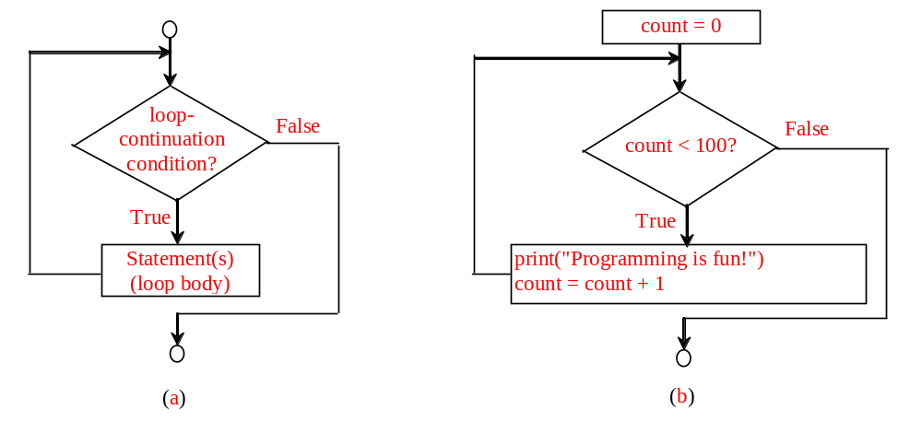
while Loop Flow Chart
count = 0
while count < 100:
print("Programming is fun!")
count = count + 1
while loop-continuation-condition:
# Loop body
Statement(s)

Slide 7
Trace while Loop
animation
Initialize count
count = 0
while count < 2:
print("Programming is fun!")
count = count + 1

Slide 8
Trace while Loop, cont.
animation
(count < 2) is true
count = 0
while count < 2:
print("Programming is fun!")
count = count + 1

Slide 9
Trace while Loop, cont.
animation
Print Welcome to Python
count = 0
while count < 2:
print("Programming is fun!")
count = count + 1

Slide 10
Trace while Loop, cont.
animation
Increase count by 1
count is 1 now
count = 0
while count < 2:
print("Programming is fun!")
count = count + 1

Slide 11
Trace while Loop, cont.
animation
(count < 2) is still true since count is 1
count = 0
while count < 2:
print("Programming is fun!")
count = count + 1

Slide 12
Trace while Loop, cont.
animation
Print Welcome to Python
count = 0
while count < 2:
print("Programming is fun!")
count = count + 1

Slide 13
Trace while Loop, cont.
animation
Increase count by 1
count is 2 now
count = 0
while count < 2:
print("Programming is fun!")
count = count + 1

Slide 14
Trace while Loop, cont.
animation
(count < 2) is false since count is 2 now
count = 0
while count < 2:
print("Programming is fun!")
count = count + 1

Slide 15
Trace while Loop
animation
The loop exits. Execute the next statement after the loop.
count = 0
while count < 2:
print("Programming is fun!")
count = count + 1

Slide 16

Problem: An Advanced Math Learning Tool
The Math subtraction learning tool program generates just one question for each run. You can use a loop to generate questions repeatedly. This example gives a program that generates five questions and reports the number of the correct answers after a student answers all five questions.
SubtractionQuizLoop

Slide 17
Problem: Guessing Numbers
Write a program that randomly generates an integer between 0 and 100, inclusive. The program prompts the user to enter a number continuously until the number matches the randomly generated number. For each user input, the program tells the user whether the input is too low or too high, so the user can choose the next input intelligently. Here is a sample run:
GuessNumberOneTime
GuessNumber

Slide 18
for Loops
i = initialValue # Initialize loop-control variable
while i < endValue:
# Loop body
...
i++ # Adjust loop-control variable
for i in range(initialValue, endValue):
# Loop body

Slide 19
range(a, b)
>>> for v in range(4, 8):
... print(v)
...
4
5
6
7
>>>

Slide 20
range(b)
>>> for i in range(4):
... print(i)
...
0
1
2
3
>>>

Slide 21
range(a, b, step)
>>> for v in range(3, 9, 2):
... print(v)
...
3
5
7
>>>

Slide 22
range(a, b, step)
>>> for v in range(5, 1, -1):
... print(v)
...
5
4
3
2
>>>

Slide 23
Nested Loops
Problem: Write a program that uses nested for loops to print a multiplication table.
MultiplicationTable

Slide 24
Problem: Predicting the Future Tuition
Problem: Suppose that the tuition for a university is $10,000 this year and tuition increases 7% every year. In how many years will the tuition be doubled?
FutureTuition
Run

Slide 25
Problem: Predicating the Future Tuition
year = 0 # Year 0
tuition = 10000
year += 1 # Year 1
tuition = tuition * 1.07
year += 1 # Year 2
tuition = tuition * 1.07
year += 1 # Year 3
tuition = tuition * 1.07
FutureTuition
Run

Slide 26
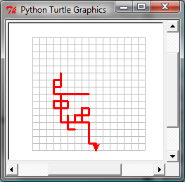
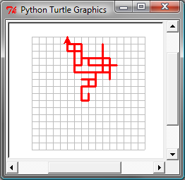
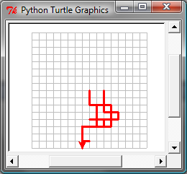
Turtle: Random Walk
RandomWalk
Run

